Slide 1

IMPLEMENTATION OF THE PROPERTY PRACTITIONERS ACT 22/2019:
-Reg: 41.22
-12 industries
- Practical effects

Slide 2
HISTORICAL FRAMEWORK
EACH FIRM HAD ITS OWN FFC
EACH FIRM HAD A PRINCIPAL AND EMPLOYEES
EACH PRINCIPAL AND EMPLOYEE HAD AN FFC UNDER THE SPECIFIC FIRM WHICH HE / SHE WAS EMPLOYED UNDER
EACH BRANCH OF A FIRM HAD ITS OWN FFC
EACH DIRECTOR HAD AN FFC INCLUDING NON EXECUTIVE DIRECTORS
EVERY FIRM AND PRINCIPAL HAD A TRUST ACCOUNT FOR WHICH THE PRINCIPAL WAS RESPONSIBLE
EACH FIRM, PRINCIPAL, EMPLOYEE AND BRANCH PAID FOR AN FFC TO BE ISSUED.

Slide 3
WHAT’S CHANGED?
EACH FIRM HAS ITS OWN FFC
EACH FIRM HAS A PRINCIPAL AND EMPLOYEES
EACH PRINCIPAL AND EMPLOYEE HAVE ONLY ONE FFC
EACH BRANCH OF A FIRM HAS ITS OWN FFC
EACH DIRECTOR HAS AN FFC BUT NON EXECUTIVE DIRECTORS APPLY FOR AN EXEMPTION AND DO NOT REGISTER
FRIMS CAN APPLY FOR AN EXEMPTION FROM A TRUST ACCOUNT IF THEY DO NOT RECEIVE TRUST MONEY
ONLY NATURAL PERSONS PAY FOR FFCs.
ADMIN FEES ARE PAYABLE FOR SERVICES NOT CHARGED FOR UNDER THE PPA.
Reg. 41.22
“Where a natural person acts as a property practitioner in different capacities within the same industry, a single fidelity fund certificate shall be issued to that natural person in respect of all capacities in which they act as a property practitioner within that industry.”

Slide 4
EFFECTS OF THE INDUSTRY BASED OR “FLOATING” FFC
PRINCIPAL, EMPLOYEES AND FIRM FFCs ARE NO LINGER INTERDEPENDENT, BUT ARE INDEPENDENTLY ISSUED.
WHEN A PRINCIPAL RENEWED HIS OWN FFC UNDER A SPECIFIC FIRM, THE FIRM FFC GENERATED AND ISSUED AUTOMATICALLY. IF HE DID NOT RENEW UNDER HIS FIRM, NO FIRM FFC OR AGENT FFC WOULD ISSUE. NOW FIRM FFCS ARE APPLIED FOR SEPARATELY.
EMPLOYEE FFCs ISSUED BASED ON FIRM AND PRINCIPAL FFC. EMPLOYEE FFCS STILL DEPEND ON THE COMPLIANCE OF THE FIRM AND THE PRINCIPAL.
PRINCIPAL: 1 FLOATING FFC FOR ALL FIRMS
EMPLOYEES: 1 FLOATING FFC FOR ALL EMPLOYERS (1 EMPLOYER FOR CANDIDATE AND FSA)
PRINCIPALS MUST REMEMBER TO RENEW THEIR OWN FFC WHEN IT EXPIRES AS WELL AS THE FIRM FFCS WHEN THEY EXPIRE. THEY MAYV NOT COINCIDE.
PRINCIPAL JOE
MONEY BAGS REALTY FFC 2025
MY PROPERTY FFC 2027
PAY ME NOW ESTATES FFC 2025
JOE DOES NOT NEED A NEW FFC FOR 2027. NO RENEWAL PAID OR REQUIRED.
2025: MONEY BAGS AND PAY ME NOW NEED TO PAY AN ADMIN FEE AND GET NEW FFCs.
2027: JOE WILL APPLY FOR HIS NEW FLOATING FFC. IT WILL NOT BE ISSUED UNDER ANY FIRM.
HE MUST SUBMIT RENEWAL DOCUMENTS FOR HIMSELF AND HIS CURRENT FIRMS.
HE WILL HAVE TO RENEW MY PROPERTY FFC THEN ALSO.

Slide 5
FIRM FFCS
CURRENTLY:
Practitioners under more than 1 firm have multiple FFCs expiring at different times.
While one of the FFCs is valid, there is no need to apply for a renewal.
Once all existing principal FFCs have expired, the next FFC will not be associated with any firm.
NOTE:
No application form will be required for a firm FFC to be issued, payment alone is required and the request template may be used. (Regulation 22 does not apply to firms)
When the principal renews his floating FFC he will apply as required by regulation 22 and submit compliant documents for himself and all his firms. He only pays for his own single FFC.
When a principal is added to an existing firm or registers a new firm under him, he does not get a new FFC, only the firm gets an FFC and payment of the admin fee for the firm FFC and the agent’s amendment of records, are required.

Slide 6
IN SUMMARY
Principals’ FFCs no longer have any association with their firm FFCs.
Employees’ FFCs no longer have any association with their employee firms’ FFCs.
Firms FFCs must be created using a separate function. Principals will need to request and pay an admin fee for their new firm FFC, when it expires,
Firm FFCs will still only generate if their principal has a valid current floating FFC.
Principals still pay a 3 year FFC fee to renew their floating FFCs.
Employees still pay their 3 year FFC fee to renew their floating FFCs.
A principal who opens a new firm or joins a new firm, does not pay for be issued with a new FFC if he has a valid current floating FFC.
For him to be registered under that firm he will pay a R640 admin fee.
For a new firm, the firm will not pay for an FFC as per regulation 15.1.
The firm will pay an admin fee of R640 to assist in covering our costs in issuing FFCs to firms for free.

Slide 7
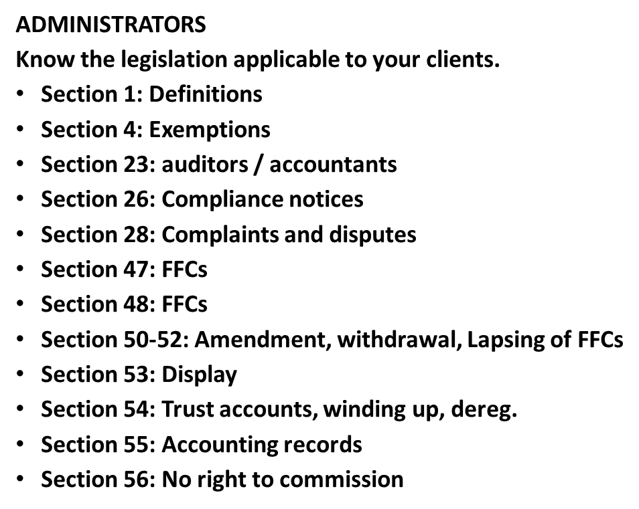
ADMINISTRATORS
Section 58: Other service providers
Section 63: Undesirable Practices
REGULATIONS
R2: Exemptions
R15: FFC fees
R20-26: FFCs, format, deadlines, penalties, amendments, updating of details.
R31: Deregistration
R34: Code of Conduct
R38: fines and contraventions
R41.22-41: Registration and FFC administration.

Slide 8
ADMINISTRATORS 2
Do you know what industry/ ies your client needs to register in?
Do you know what constitutes a compliant registration application / FFC renewal / exemption application, or when these are required?
Do you check for compliance to avoid delays?
What standards of training apply to register a developer
/ auctioneer / mortgage originator?
What is a payment processing agent?
What will you say if your client tells you he doesn’t have to register as a developer because the definition doesn’t include a developer anywhere?
how do you register an auctioneer firm? Who is a principal? What is the status of his agents?
Send registration documents in separate folders or attachments.
Check for accuracy.
Use correct pin numbers.
Understand the difference between an FFC number and a pin number.

Slide 9
CURRENT PORTAL ISSUES
Registration of new agents and generation of pin numbers.
Display of FFCs incorrect.
Download of FFCs not available.
Principals access to firm details not available.
SOLUTION
Request a copy
Request a letter
Development and repairs ongoing
New Registrations and Licencing portal
Statistical updates
Registrations activities, information and notices- employees, FFCs, etc.

Slide 10
12 INDUSTRIES ON REGISTRATIONS SYSTEM
The 12 industries are now registering on the SAP system.
FFCs now issued via the system.
All industries will show on new portal.
All registration applications will come via the portal for all industries.
Practitioners will register on the portal for any industry / ies.
Phase 1 and 2.
FFCs are required in each industry if you operate in multiple industries.
Currently register via registrations@theppra.org.za.

Slide 11
12 CATEGORIES OF PROPERTY PRACTITIONERS UNDER THE PPA
Estate agents
Auctioneers
Bond and bridging finance originators
HOAs who perform property practitioner activities
Managing agents
Property facilitators and intermediaries
Business brokers, including sales of franchises and business undertakings
Developers who market and sell their own developed property
Time share and fractional ownership practitioners
Property advertising platforms
Property practitioners who specialise in collecting and distributing trust monies in terms of Regulation 2.4.1. (Payment processing agents)
Attorney employees

Slide 12
REGISTRATION PROCESS IS EVOLVING IN LINE WITH NEW REQUIREMENTS
NON ESTATE AGENT PRACTITIONERS- ALL OTHER INDUSTRIES: FIRM REGISTRATION
REGISTRATION IS BY A DIRECTOR SUBMITTING TO
registrations@theppra.org.za
Business property practitioner registration form- signed by all directors,
Required documents:-
FIRM DOCUMENTS: CIPC or firm documents, bank letter confirming trust account held in terms of section 54(1) or trust exemption certificate, auditor’s letter of confirmation for entities holding a trust account, a company resolution, valid BEE certificate (not necessarily compliant), for juristic entities, SARS tax clearance certificate for all firms, proof of payment of statutory and administration fees.

Slide 13
REGISTRATION OF INDIVIDUAL PPs. (PERSONS)
DIRECTORS REGISTER THEMSELVES INDIVIDUALLY
Directors submit all documents to the same email address with their firm application:
ID document.
Individual property practitioner application form, completed and signed.
E1 form applying for exemption from Regulation 33,
Proof of payment of registration and admin fee.
EMPLOYEES (ALL LEVELS)
Individual PP application form, completed and signed.
E1 form applying for exemption from Regulation 33 (education).
Letter of employment signed by director and employee, stating reference number of director and firm.
Proof of payment of registration fee.
Submission to the same registrations@theppra.org.za

Slide 14
REGISTRATION OF ESTATE AGENT PPs
PRINCIPALS REGISTER THEIR FIRM AND THEMSELVES INDIVIDUALLY AS PREVIOUSLY AND SUBMIT TO registrations@theppra.org.za.
FIRMS:THE SAME PROCESS AS FOR NON-ESTATE AGENT BUSINESS PROPERTY PRACTITIONER: BPP APPLICATION FORM SIGNED BY PRINCIPALS
PRINCIPALS submit the following documents:
ID document.
Individual property practitioner application form, completed and signed.
Principal qualifications.
Proof of payment of registration fee.
CANDIDATES
Individual PP application form, completed and signed
Letter of employment signed by director and employee, stating reference number of director and firm,
Proof of payment of registration fee
Submission to the same registrations@theppra.org.za

Slide 15
GENERAL CHANGES
FORMAT OF FFCS
UPGRADES- NO FFC ISSUED
EFFECT OF DEREGISTRATION OF FIRM ON FFCS
WHY ADMINISTRATIVE FEES ARE PAYABLE
SYSTEM UPGRADES
TIME PERIODS FOR ISSUING OF FFCS
REQUIREMENTS F,OR FFC RENEWAL

Slide 16
SECTION 49
49. (1) The Authority must, within 30 working days, consider any application
submitted to it in terms of this Act, which fully meets the prescribed requirements,
unless the Authority, on good grounds in writing, informs the applicant of the reasons
why that period is to be extended, provided that such extension may not exceed 20
working days.
(2) The period of 30 working days contemplated in subsection (1) commences afresh
if the Authority requests the applicant to submit additional information or to correct the
said application.
(3) If the Authority has failed to comply with subsection (1), the application is deemed
to have been approved and the Authority must, upon written request by the applicant
within 10 working days, issue the applicant with the relevant certificate.

Slide 17
ANALYSIS OF SECTION 49(1) and (3)
The PPRA must-
Consider an application which fully meets the requirements (fully compliant)
If the application is fully compliant, issue an FFC
Within 30 working days.
If we don’t consider a fully compliant application within the 30 days, the fully compliant application is deemed to have been compliant and we must issue the FFC within 10 working days.
If it never fully met the requirements, no deeming provision applies.
Ss49(3) specifically refers to a 49(1) application and not a 49(2) application.
If it fully meets the requirements, then we have 30 working days to issue the FFC.
After the 30 days, we have another 10 working days to issue the FFC.
Drafting- no deeming provision that you are deemed to have been issued with the FFC, only that the application was compliant.

Slide 18
FOR NOTING
Section 4 exemptions / equivalency exemptions / trust account exemptions:
  Costs differ, address differs, criteria differ
  section4exemptions@theppra.org.za
  exemptions@theppra.org.za
  audit@theppra.org.za
  Exemption application form / prescribed affidavit reg.2.
  CPD Zandile.Mahlangu@theppra.org.za.
  Escalation to EM and CEO.

Slide 19

GENERAL
PLEASE
Do not send an enquiry without a pin number.
Do not copy the EM and CEO on ordinary emails. Their emails are for escalation or legal enquiries, not for general registration matters.
New website with search capability- Read notices on the website.
Do not send emails to multiple people.
Do not send emails 15 times a week.
Note the 30 working day turnaround time for FFCs. (S49).
Be accurate.
Be clear.
Do not ask for something that is prohibited by the PPA.
Report stupid administrators to the EM or Vukani first, then if you get no joy escalate to CEO.
CEO cannot give permission to be non-compliant, even if she wants to.
Report corruption.
Report the date, time and person at the call centre who is useless.

Slide 20
THANK YOU
QUESTIONS

